Slide 1
Mini Popper | Colt poppers | Pepper poppers | Plates | Wall feet
3 | 4 | 1 | 0 | 56
Bay | Stage | Target Type | Count | NS | Total | Hard Cover
C1 | Ain't No Thing | USPSA | 6 | 2 | 8 | 1 Tux
C2 | New Year Same Old | USPSA | 12 | 2 | 14 | 1 Tux
B1 | To The ENd | IPSC | 11 | 2 | 13 | 1 Tux 1 Right Diag
B2 | Don't Forget to Fire 3 | USPSA | 10 | 1 | 11
B3 | CM 22-07 | USPSA | 7 | 2 | 9
B4 | Speed and Power | USPSA | 3 | 1 | 4

Slide 2
Prop | Stage
Swinger | Stage 2, Bay A1
Swinger | Stage 6, Bay B4
Max trap | Stage 6, Bay B4

Slide 3

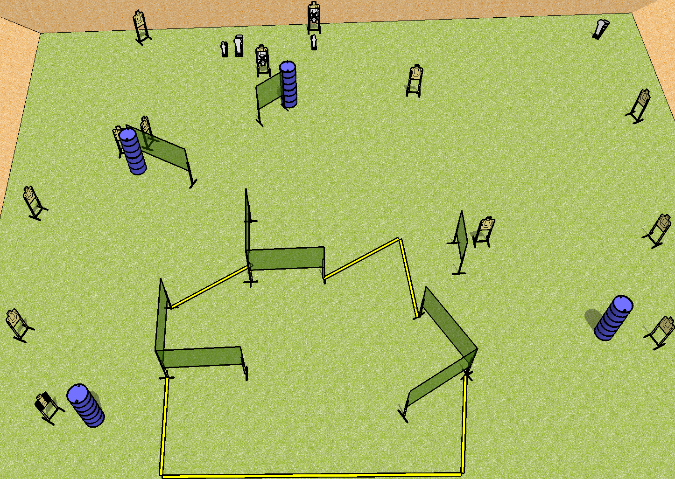
 | Dothan Practical Shooters – USPSA Match New Year Same Old Course Designer : Drew Coleman Bay: A2
Round Count 30 rounds 13 USPSA 2 minis, 2 colts
Equipment List 15 wall feet 14 targets (12 + 2 NS) 1 tux

Slide 4
New Year Same Old
Written Stage Briefing
Scoring: Comstock Rounds: 30
Targets: 13 USPSA, 4 steel
Handgun start position: anywhere inside the shooting area, wrists below belt. Handgun is loaded and holstered.
PCC start position: anywhere inside the shooting area, stock on belt. Loaded PCC is held with both hands, safety on.
Stage Procedure: on the audible start signal, engage targets as they become available from within the shooting area.

Slide 5
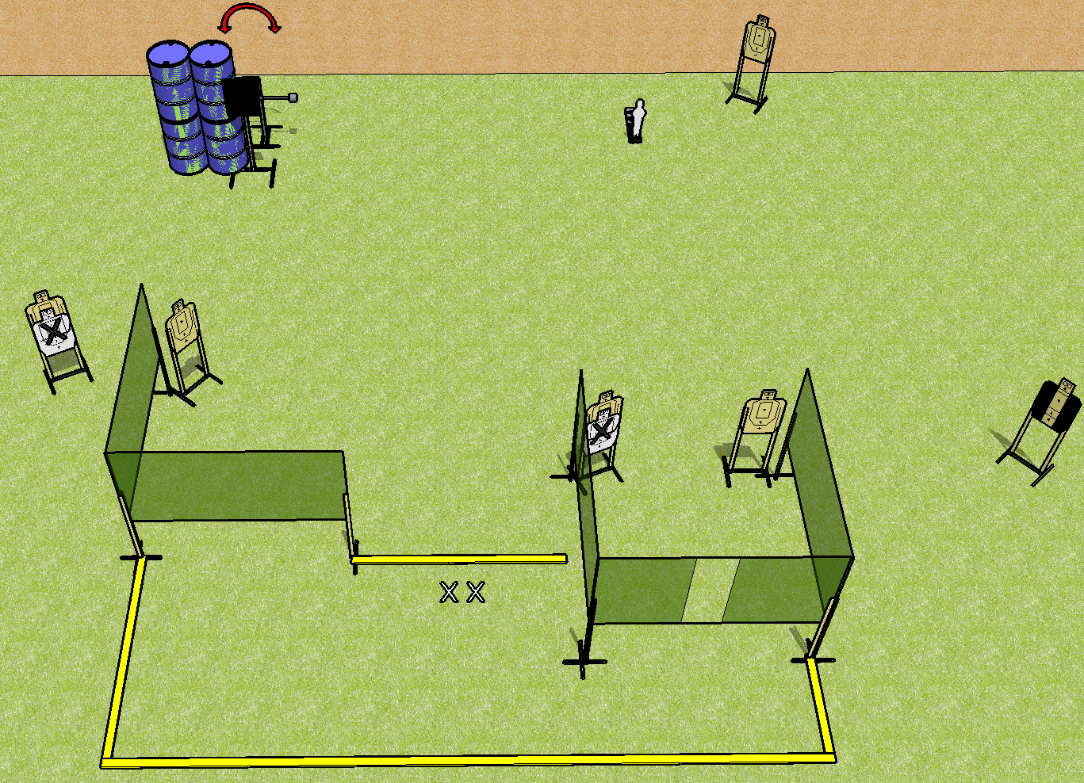
 | Dothan Practical Shooters – USPSA Match Ain’t No Thing Course Designer : Drew Coleman Bay: A1
Round Count 15 rounds 7 USPSA, 1 mini popper
Equipment List 7 wall feet Swinger + activator 8 targets (6 + 2NS), 1 tuxedo

Slide 6
Ain’t No Thing
Written Stage Briefing
Scoring: Comstock Rounds: 15
Targets: 7 USPSA, 1 steel
Handgun start position: feet on X’s, wrists below belt. Handgun is loaded and holstered.
PCC start position: feet on X’s, stock on belt. Loaded carbine is held with both hands, safety on.
Stage Procedure: on the audible start signal, engage targets as they become available from within the shooting area. T1 is activated by P1 and remains visible at rest.

Slide 7
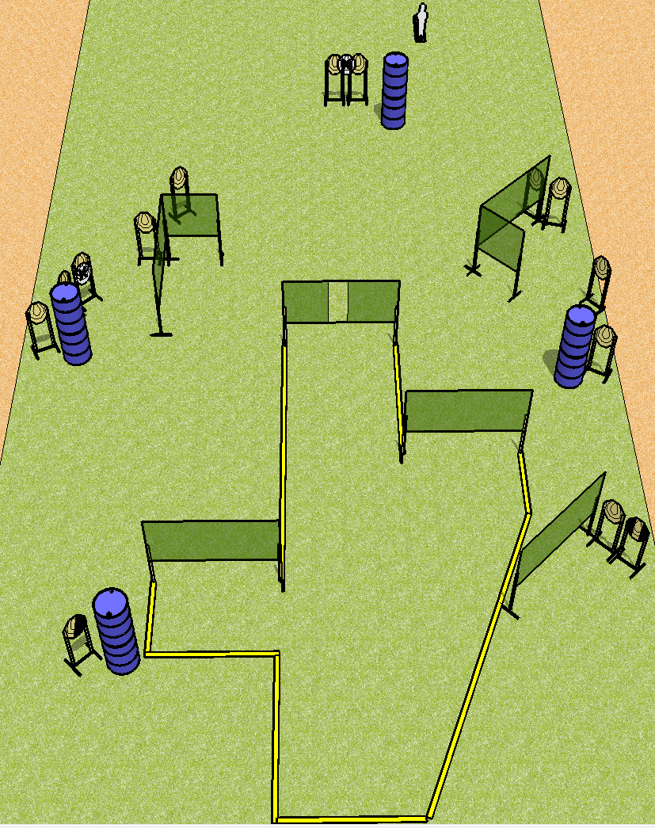
 | Dothan Practical Shooters – USPSA Match To The End Course Designer : Drew Coleman Bay: B1
Round Count 27 rounds 13 IPSC 1 pepper popper
Equipment List 14 wall feet 13 targets (11 + 2 NS) 1 tux, 1 right diag

Slide 8
To The End
Written Stage Briefing
Scoring: Comstock Rounds: 27
Targets: 13 IPSC, 1 steel
Handgun start position: anywhere completely outside the shooting area, wrists below belt. Handgun is loaded and holstered.
PCC start position: anywhere completely outside the shooting area, stock on belt. Loaded carbine is held with both hands, safety on.
Stage Procedure: on the audible start signal, engage targets as they become available from within the shooting area.

Slide 9
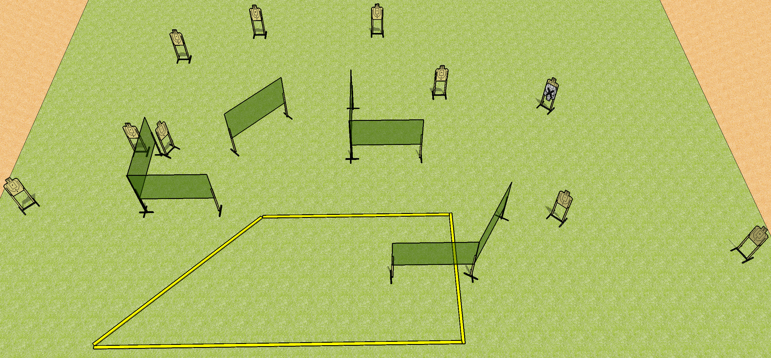
 | Dothan Practical Shooters – USPSA Match Don’t Forget To Fire 3 Course Designer : Drew Coleman Bay: B2
Round Count 30 rounds 10 USPSA
Equipment List 12 wall feet
20’
20’

Slide 10
Don’t Forget To Fire 3
Written Stage Briefing
Scoring: Comstock Rounds: 30
Targets: 10 USPSA, best 3 per target
Handgun start position: anywhere inside the shooting area, wrists below belt. Handgun is loaded and holstered.
PCC start position: anywhere inside the shooting area, stock on belt. Loaded carbine is held with both hands, safety on.
Stage Procedure: on the audible start signal, engage targets as they become available from within the shooting area.

Slide 11
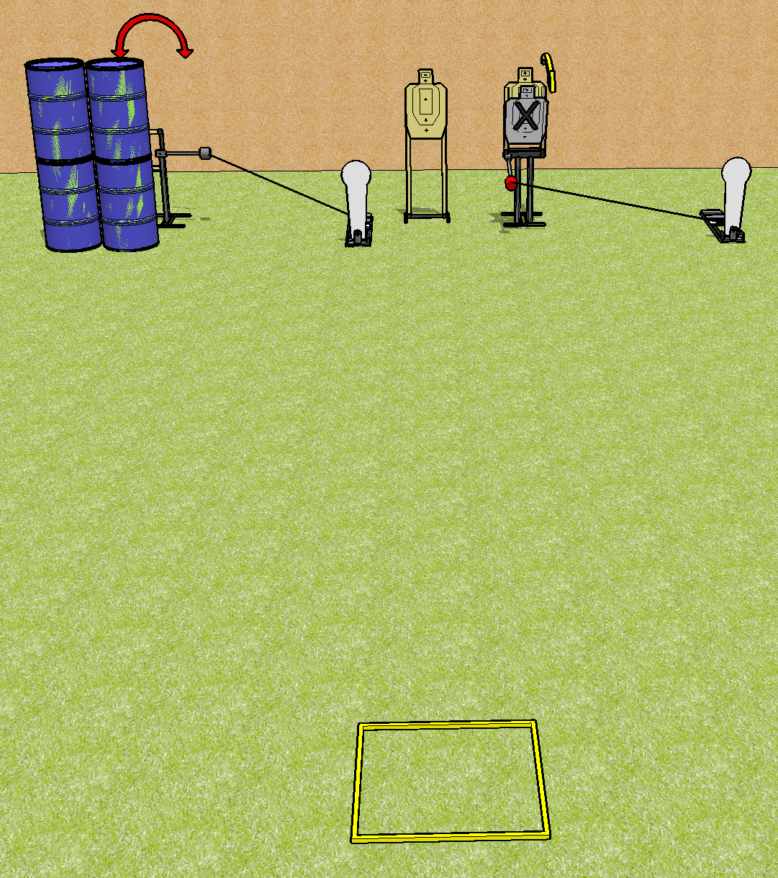
 | Dothan Practical Shooters – USPSA Match Speed and Power Course Designer : Drew Coleman Bay: B4
Round Count 8 rounds 3 USPSA 2 colt poppers
Equipment List Swinger + activator Max trap + activator Shooting box 4 targets (3 + 1NS)

Slide 12
Speed and Power
Written Stage Briefing
Scoring: Comstock Rounds: 8
Targets: 3 USPSA, 2 steel
Handgun start position: anywhere inside the shooting area, facing up range, wrists above shoulders.
PCC start position: anywhere inside the shooting area, stock on belt. Loaded carbine is held with both hands, safety on.
Stage Procedure: on the audible start signal, engage targets as they become available from within the shooting area. T1 is activated by P1 and remains visible at rest. T3 is activated by P2 and remains visible at rest.

